Slide 1

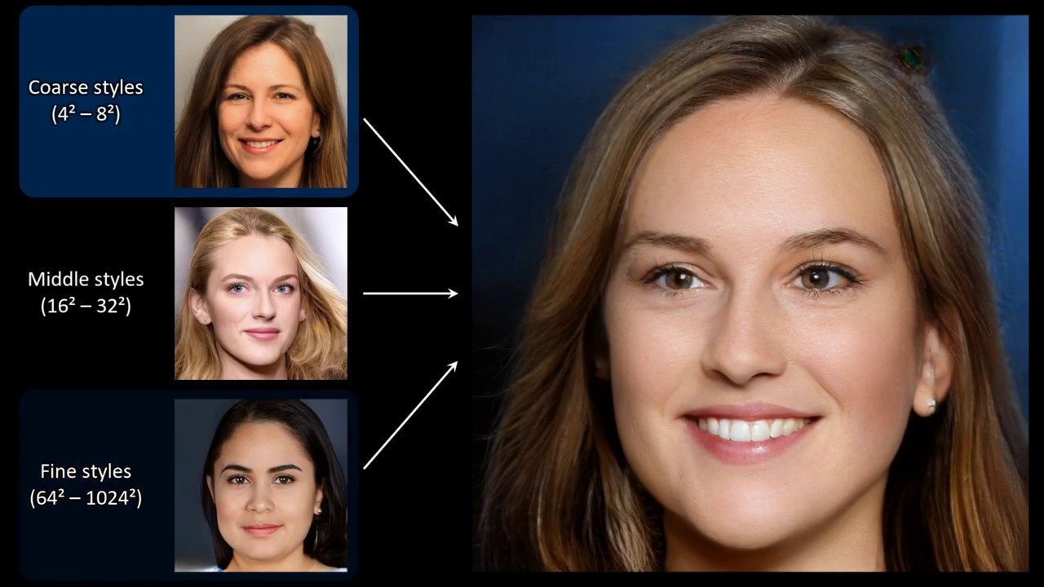



Face Generator / Face Layer Extraction

Slide 2
Z
vector
Generator
X’
X
Discriminator
1
0
GAN : Generator Aggressive Network

Slide 3
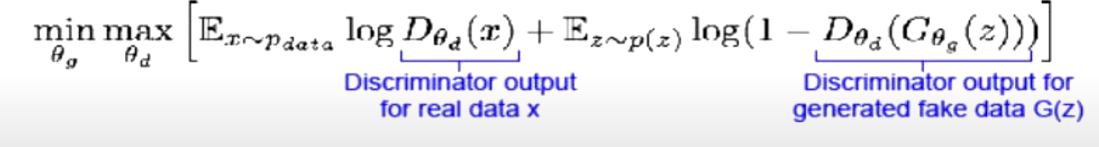
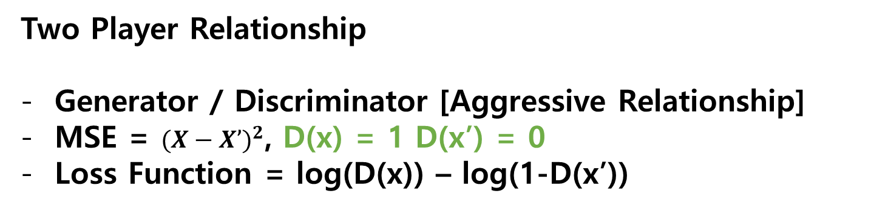
GAN Structure
Generator Aggressive Network
Z
vector
Generator
X’
X
Discriminator
1
0
Two Player Relationship
Generator / Discriminator [Aggressive Relationship]
MSE = ${(X−X’)}^{2}$, D(x) = 1 D(x’) = 0
Loss Function = log(D(x)) – log(1-D(x’))

Slide 4
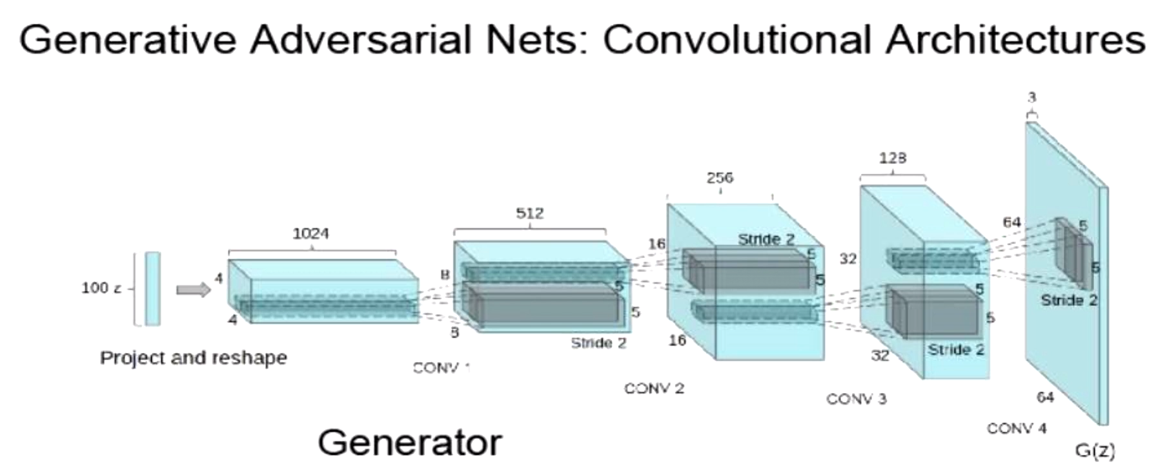
GAN Structure
Z
vector
Generator
X’
X
Discriminator
1
0
Loss Function = $log\left(D\left(x\right)\right)−log(1−D\left(x^{′}\right))$ // Unstable $x′≅x$
Loss Function [MIN, MAX ] => 2JSD
Generator, Discriminator Capacity Problem Occurred
KLD ; 쿨백 라이블러 발산 – 비가역적 성질에 의해 실질적 적용이 어려움
JSD ; 젠슨-섀넌 발산 - 2개의 KLD를 구하여 평균을 구함. 수학적으로 계산.
거리함수와 Wasserstein 거리 - 가우시안 분포를 다른 가우시안 분포로의 정규화할 때, 비용을 계산. 가장 적은 비용 채택[EarthMover]

Slide 5
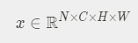
Style GAN
From Nvidia
Instance Normalization
Batch Normalization
Batch Normalization
Instance Normalization
Adaptive Normalization [Hybrid Form]
Z
X
Linear
Ŷ
Softmax

Slide 6
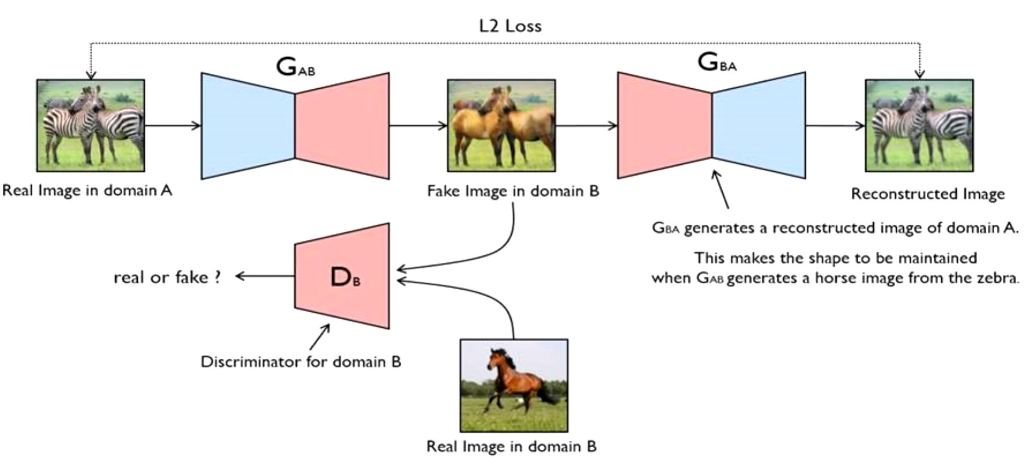
Style GAN
SEED
ENTANGLED / DISENTANGLED
Z to pixel Desired
Pixel to pixel ? Efficiency Loss
MUST BE
ENTANGLED
Generator
X
Discriminator

Slide 7
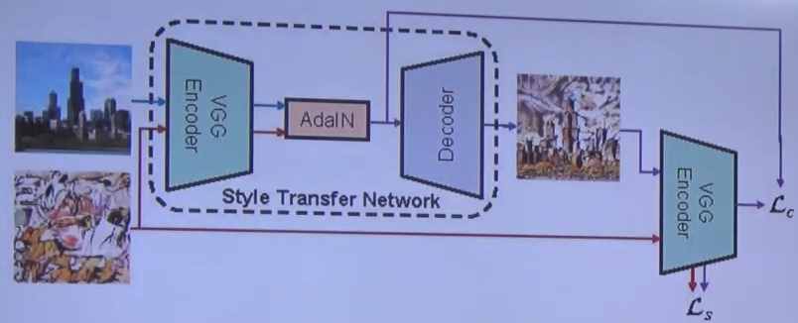
Style GAN
Style Transfer Network
X : Seed
Y : Seed
X
X’
T
Y
Loss Function with t
T is function with X
Loss Function with y

Slide 8
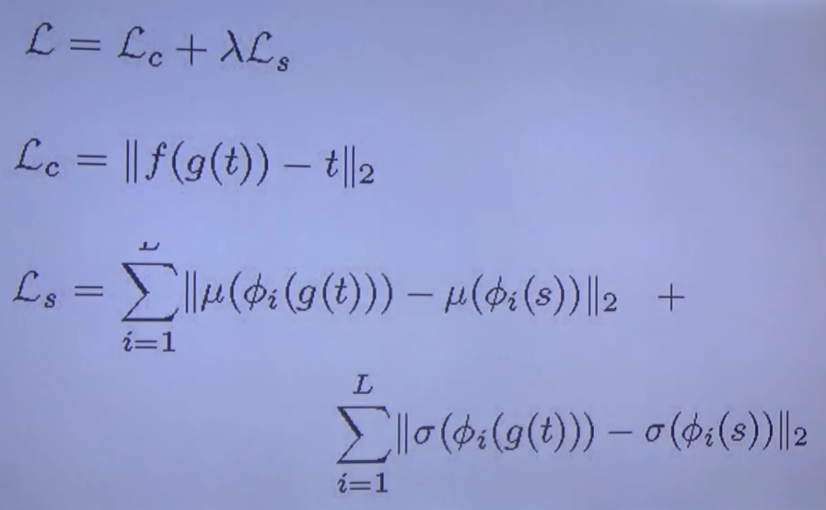
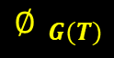
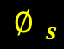
Original Style GAN
Style Transfer Network
X : Seed
Y : Seed
X
G(T)
X’
$${∅ }_{G(T)}$$
T
Y
Loss Function with t
$${∅ }_{s}$$
T is function with X
Loss Function with y

Slide 9
NVIDIA Style GAN
Scale Vector[Non-Pixel To Pixel]
DISENTANGLED
ALTERNATIVE GENERATOR
INTERMEDIATE LATENT

Slide 10
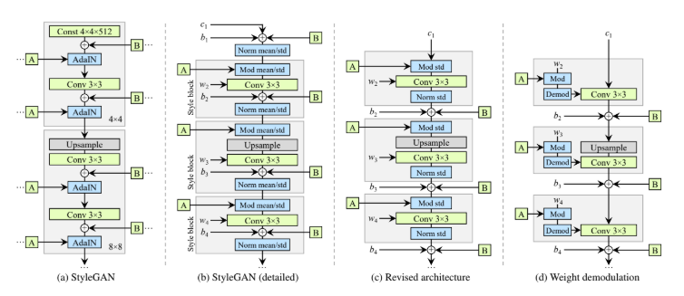
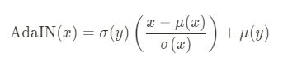
NVIDIA Style GAN
Scale Vector[Non-Pixel To Pixel]
DISENTANGLED
ALTERNATIVE GENERATOR
INTERMEDIATE LATENT
Z[Generator]
Adain
y
y
y
discriminator
Random noise
y

Slide 11





NVIDIA Style GAN
Removing Normalization Artifacts
Z
vector
Generator
X’
1 : approve
MainStream
Generator Architecture revisited
X
Discriminator
0 : reject
Instance Normalization revisited
Architecture : Stylegan2
Find Common Blob-like artifacts
Removing Normalization Artifacts
Generator Architecture revisited
Instance Normalization revisited

Slide 12
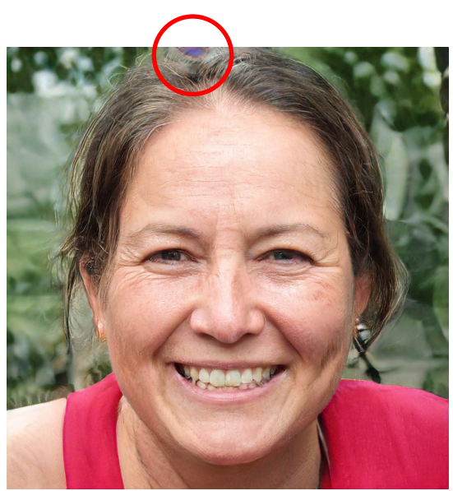
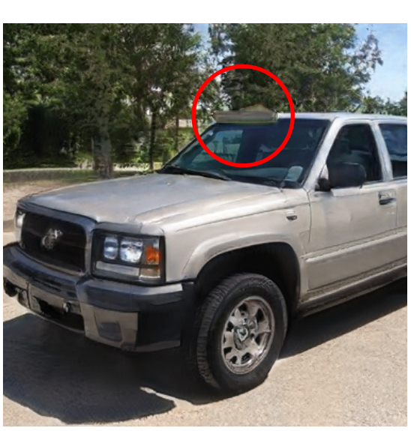

Slide 13
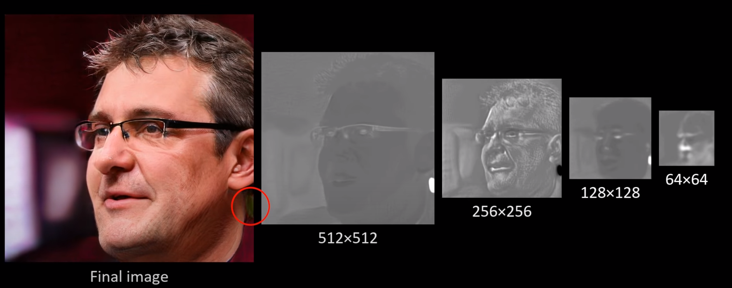

Slide 14
